Slide 1
Installation of ROS Noetic

Slide 2
ROS Noetic is compatible with Ubuntu 20.04 version
So first install Ubuntu 20.04; either dual boot or Virtual box or
VMWare

Slide 3
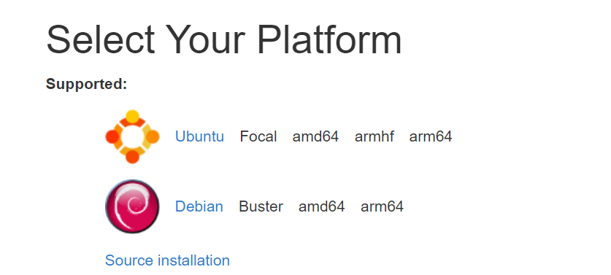
ROS Installation
http://wiki.ros.org/noetic/Installation

Slide 4
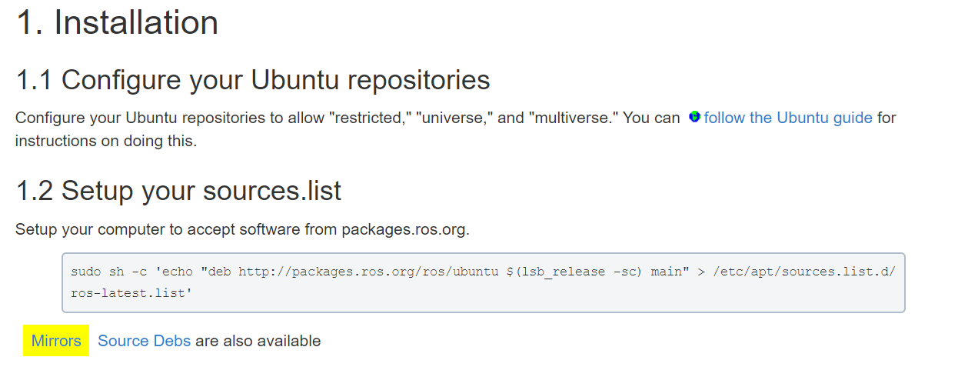
http://wiki.ros.org/noetic/Installation/Ubuntu

Slide 5
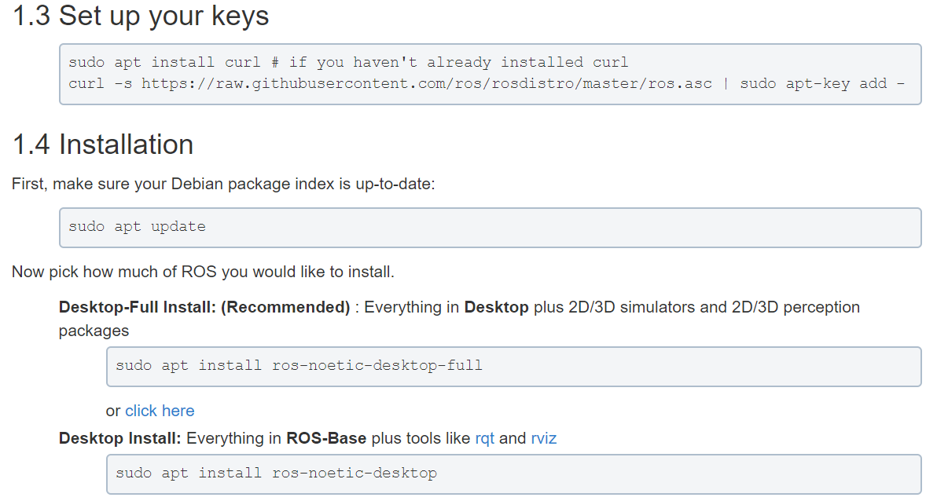

Slide 6
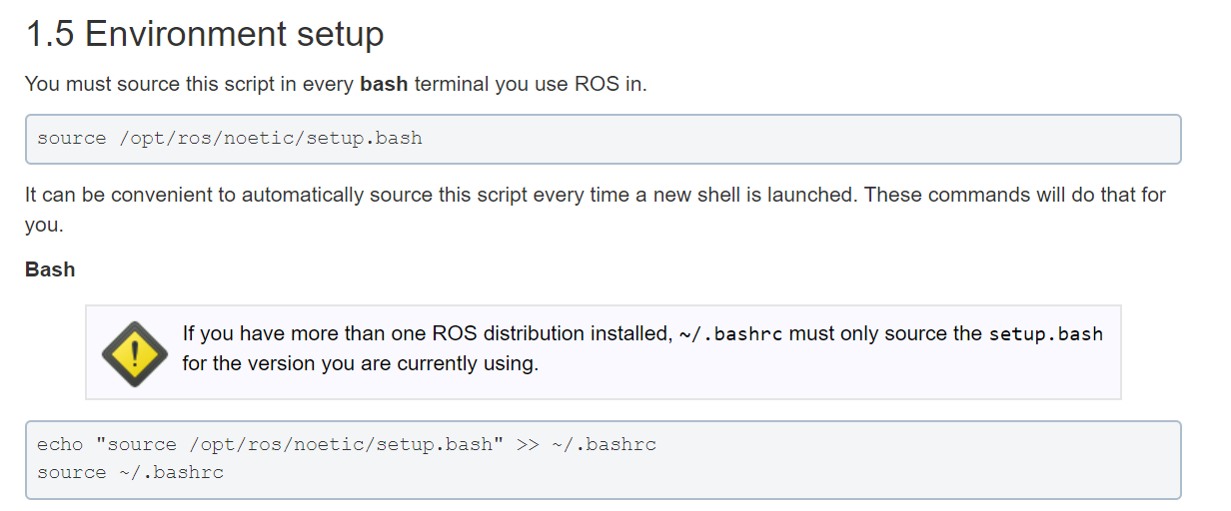

Slide 7
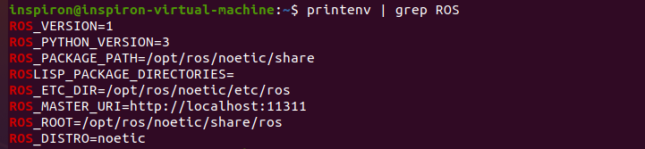
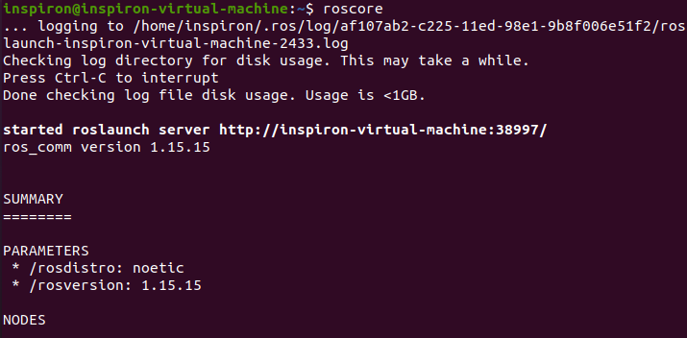
Outputs

Slide 8
